Slide 1
CSE 219
Computer Science III
Threads & Timers

Slide 2
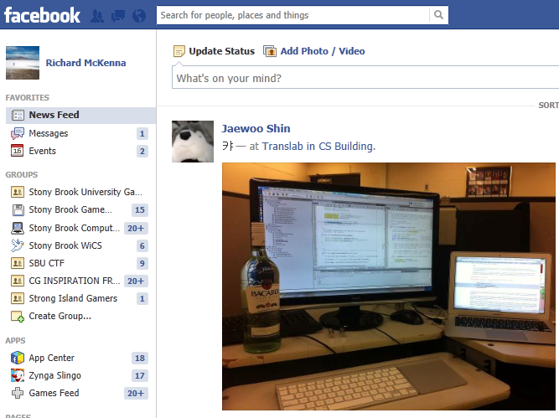

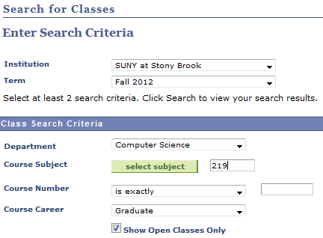
Multi-tasking
When you’re working, how many different applications do you have open at one time?

Slide 3


Multithreaded?
When you request a Web page. Should IE:
  wait for the page before doing anything else
    OR
  do other work while waiting
    like responding to user input/rendering

Slide 4
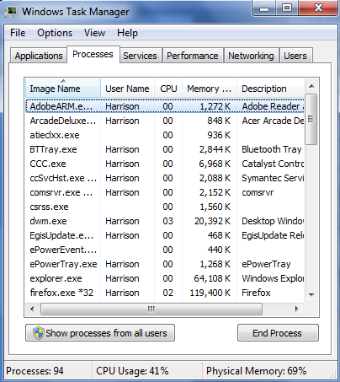
OS Multi-tasking
How many tasks is the OS performing?
  3-fingered salute
How many CPUs does your PC have?

Slide 5

Tools for OS Multi-tasking
Threads
Thread scheduling
Time-sharing
Virtual Memory
CSE 306

Slide 6
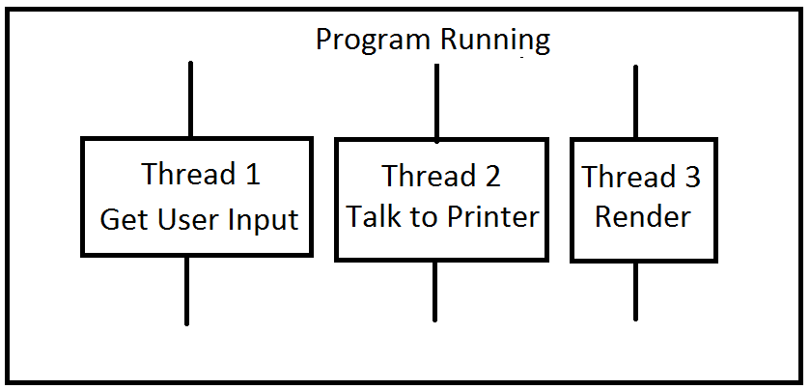
Program Multi-Tasking
Most apps need to do multiple tasks “simultaneously”
For example:
  getting user input
  printing
  Internet
How would you do this?
  using threads (that you define)
  AND
  using a thread scheduler (that the JVM provides)

Slide 7


Multi-Core Complicates Everything
Intel Xeon E7
  10 Cores
  20 Threads
We'll ignore multicore
  let the OS work it out
We'll assume a single core

Slide 8


Threads and the Thread Scheduler
You define your own threads
  i.e. tasks
  Note: main is its own thread
You make your threads runnable
  i.e. start them
Java's thread scheduler decides order
What order should it use?

Slide 9
State transitions of a thread
new
start
unblock thread
blocked
runnable
run method ends
block thread
dead

Slide 10
new state
A constructed Thread object
Not yet started
Not yet known to thread scheduler
Not runnable
new

Slide 11
New – to – Runnable Transition
Constructed thread is started
  call start method on it
Can be scheduled
There may be many threads in this state
new
start
runnable

Slide 12
Runnable – to – Blocked Transition
Runnable thread made unrunnable
  call sleep method on it (for X milliseconds)
    directly or via lock method
Can not be scheduled
There may be many threads in this state
blocked
runnable
block thread

Slide 13
Blocked – to – Runnable Transition
Unrunnable thread made runnable
  sleep time expires
    and is not renewed
      unlock method ensures this
Can be scheduled
unblock thread
blocked
runnable

Slide 14
Runnable – to – Dead Transition
Run method completes
Cannot be rescheduled
Dead is Dead
Call isAlive to take a pulse
runnable
run method ends
dead

Slide 15
Defining your own threads
public class MyThread extends Thread {
...
public void run() {
// task to do when
// the thread is started
}
}
Create a new thread:
MyThread mT = new MyThread();
Run the thread:
mT.start();

Slide 16
The 2 key Thread methods
start()
  makes thread runnable
  calls the run method
  Thread class’ start method already does all of this
    if your class that extends Thread you don’t have to define start
run()
  executed when a thread is start()ed
  where thread work is done (the point of it all)
  Thread class’ run method does nothing
    if your class extends Thread you must define run
      to specify what work your thread will do

Slide 17
For you, run >> start
Method Summary
void | run() When an object implementing interface Runnable is used to create a thread, starting the thread causes the object's run method to be called in that separately executing thread.
run does all the work
run may do one thing or many
  via iteration
  it may even exist for the duration of the program

Slide 18
start vs. run
All code executes within a thread of execution
  even the main method has a thread
    public static void main(String[] args) {
MyThread t = new MyThread();
t.start();
…
Now we have 2 threads. What about:
    public static void main(String[] args) {
    MyThread t = new MyThread();
      t.run();
      …
Still just 1 thread. Why?

Slide 19
Run vs. Start Example
public class RandomThread extends Thread
{
public void run()
{
while (true)
{
int num = (int) (Math.random() * 10);
System.out.println("\t\t\t\t" + num);
try { Thread.sleep(10); }
catch(InterruptedException ie) {}
}
}
}

Slide 20
What will StartTester do?
public class StartTester
{
public static void main(String[] args)
{
RandomThread thread = new RandomThread();
thread.start();
while (true)
{
Calendar today = new GregorianCalendar();
long hour = today.get(Calendar.HOUR);
long minute = today.get(Calendar.MINUTE);
long second = today.get(Calendar.SECOND);
System.out.println(hour + ":"
+ minute + ":" + second);
try { Thread.sleep(10); }
catch(InterruptedException ie) {}
}
}
}
THIS IS A MULTITHREADED APPLICATION!

Slide 21
What will RunTester do?
public class RunTester
{
public static void main(String[] args)
{
RandomThread thread = new RandomThread();
thread.run();
while (true)
{
Calendar today = new GregorianCalendar();
long hour = today.get(Calendar.HOUR);
long minute = today.get(Calendar.MINUTE);
long second = today.get(Calendar.SECOND);
System.out.println(hour + ":"
+ minute + ":" + second);
try { Thread.sleep(10); }
catch(InterruptedException ie) {}
}
}
}
THIS IS NOT A MULTITHREADED APPLICATION!

Slide 22
Runnable interface
What if we want to make our frame multi-threaded?
  it already extends JFrame
Alternative appraoch:
  use implements Runnable
  AND
  define start AND run
Runnable interface has 1 method: run
What class do you think implements Runnable?

Slide 23
public class RandomFrame extends JFrame implements Runnable
{
private Thread proxyThread = null;
public void run()
{
JLabel numLabel = new JLabel("");
add(numLabel);
int counter = 0;
while (counter < 1000)
{
counter++;
numLabel.setText("" + counter);
try { Thread.sleep(10); }
catch(InterruptedException ie) {}
}
}
public void start()
{
if (proxyThread == null)
{
proxyThread = new Thread(this);
proxyThread.start();
}
}
public Thread(Runnable target)
Specifies whose run method should be called when the thread executes

Slide 24
RunnableFrame (continued)
public static void main(String[] args)
{
RandomFrame frame = new RandomFrame();
frame.start();
frame.setVisible(true);
}
}
Starts JFrame's thread

Slide 25
Killing a thread
Threads usually perform actions repeatedly
What if you want to tell a thread to stop doing what it’s doing?
This takes cooperation between threads

Slide 26
Do not use the stop method
Why?
  it's deprecated
  Why?
    It kills threads immediately
    a thread’s run method may be mid-algorithm when killed
Preferred option: ask thread to kill itself. How?
  via your own instance variable
    make it a loop control for run
    lets the thread set its affairs in order before dying

Slide 27
Typical run structure
public class NiceThread extends Thread
{
  private boolean die = false;
  public void askToDie() { die = true; }
  public void run() {
    while (!die) {
      // do work here
      try {sleep(someAmountOfTime); }
      catch (InterruptedException ie) { }
    }
    // set affairs in order}
  }
  // DEAD IS DEAD
}

Slide 28
Timer Threads
Common Problem:
  Need program to do something X times/second
Like what?
  count time
  display time
  update and render scene
2 Java Options:
  have your thread do the counting
  have a Java Timer do the counting

Slide 29
Java Timers
Execute TimerTasks on schedule
  via its own hidden thread
What do we do?
  define our own TimerTask
  put work in run method
  construct our task
  construct a timer
  schedule task on timer
cancel unschedules our task (i.e. kills it)

Slide 30
SceneRenderer
SceneRenderer HAS-A Timer
private Timer animationTimer;
We defined our own task:
public class AnimateAndRenderTask extends TimerTask
SceneRenderer HAS-A AnimateAndRenderTask
private AnimateAndRenderTask animator;
startScene gets the timer up and running:
animator = new AnimateAndRenderTask(sprites, this);
animator.pauseScene();
animationTimer.scheduleAtFixedRate(animator, 0L,
FRAME_RATE);

Slide 31
What does our task do?
public class AnimateAndRenderTask extends TimerTask
{
…
public void run()
{
  if (!scenePaused)
  {
    for (Sprite spriteToAnimate : spritesToAnimate)
    {
      float timeScaler = renderer.getTimeScaler();
      spriteToAnimate.update(timeScaler);
    }
    renderer.repaint();
  }
}
}
Update all sprites
Force repaint of scene

